Slide 1
ADVISOR MEETING 3/10

Slide 2
AGENDA FOR TODAY’S MEETING (30 min)
Introductions
Progress Report
Brief overview of Proposal Slides
Reviewing proof of concept Calculations (LINK)
Planning future meetings (Last 5 minutes)
Weekly or every other week? Does this time work regularly?
Diagram of heat flow → Add some pictures to calculations

Slide 3
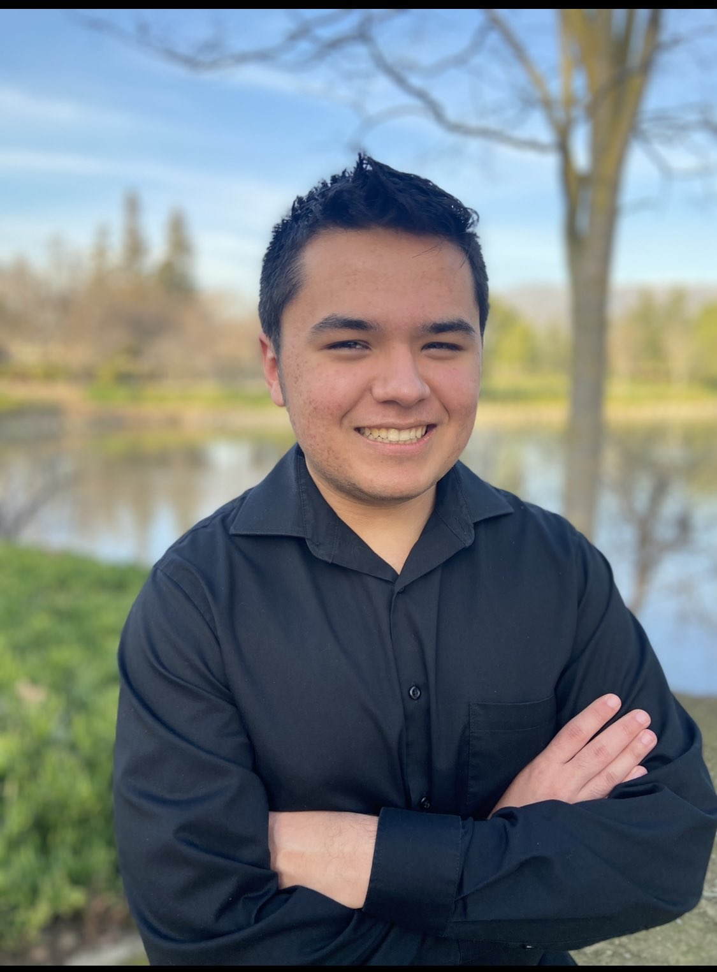
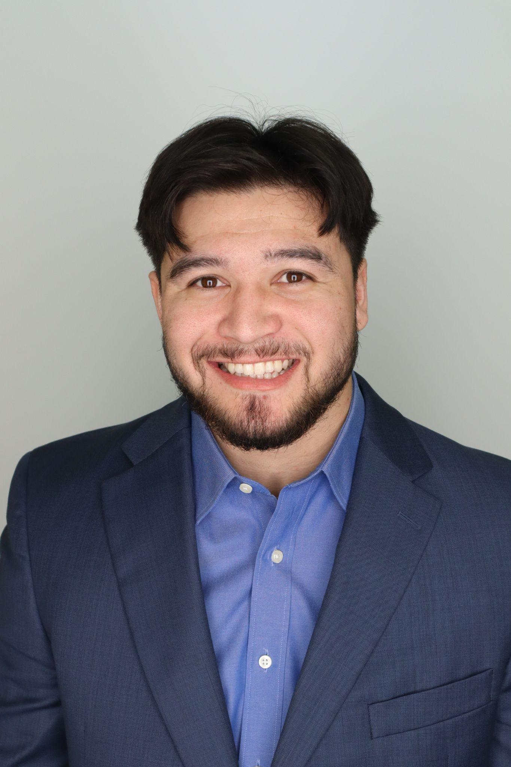
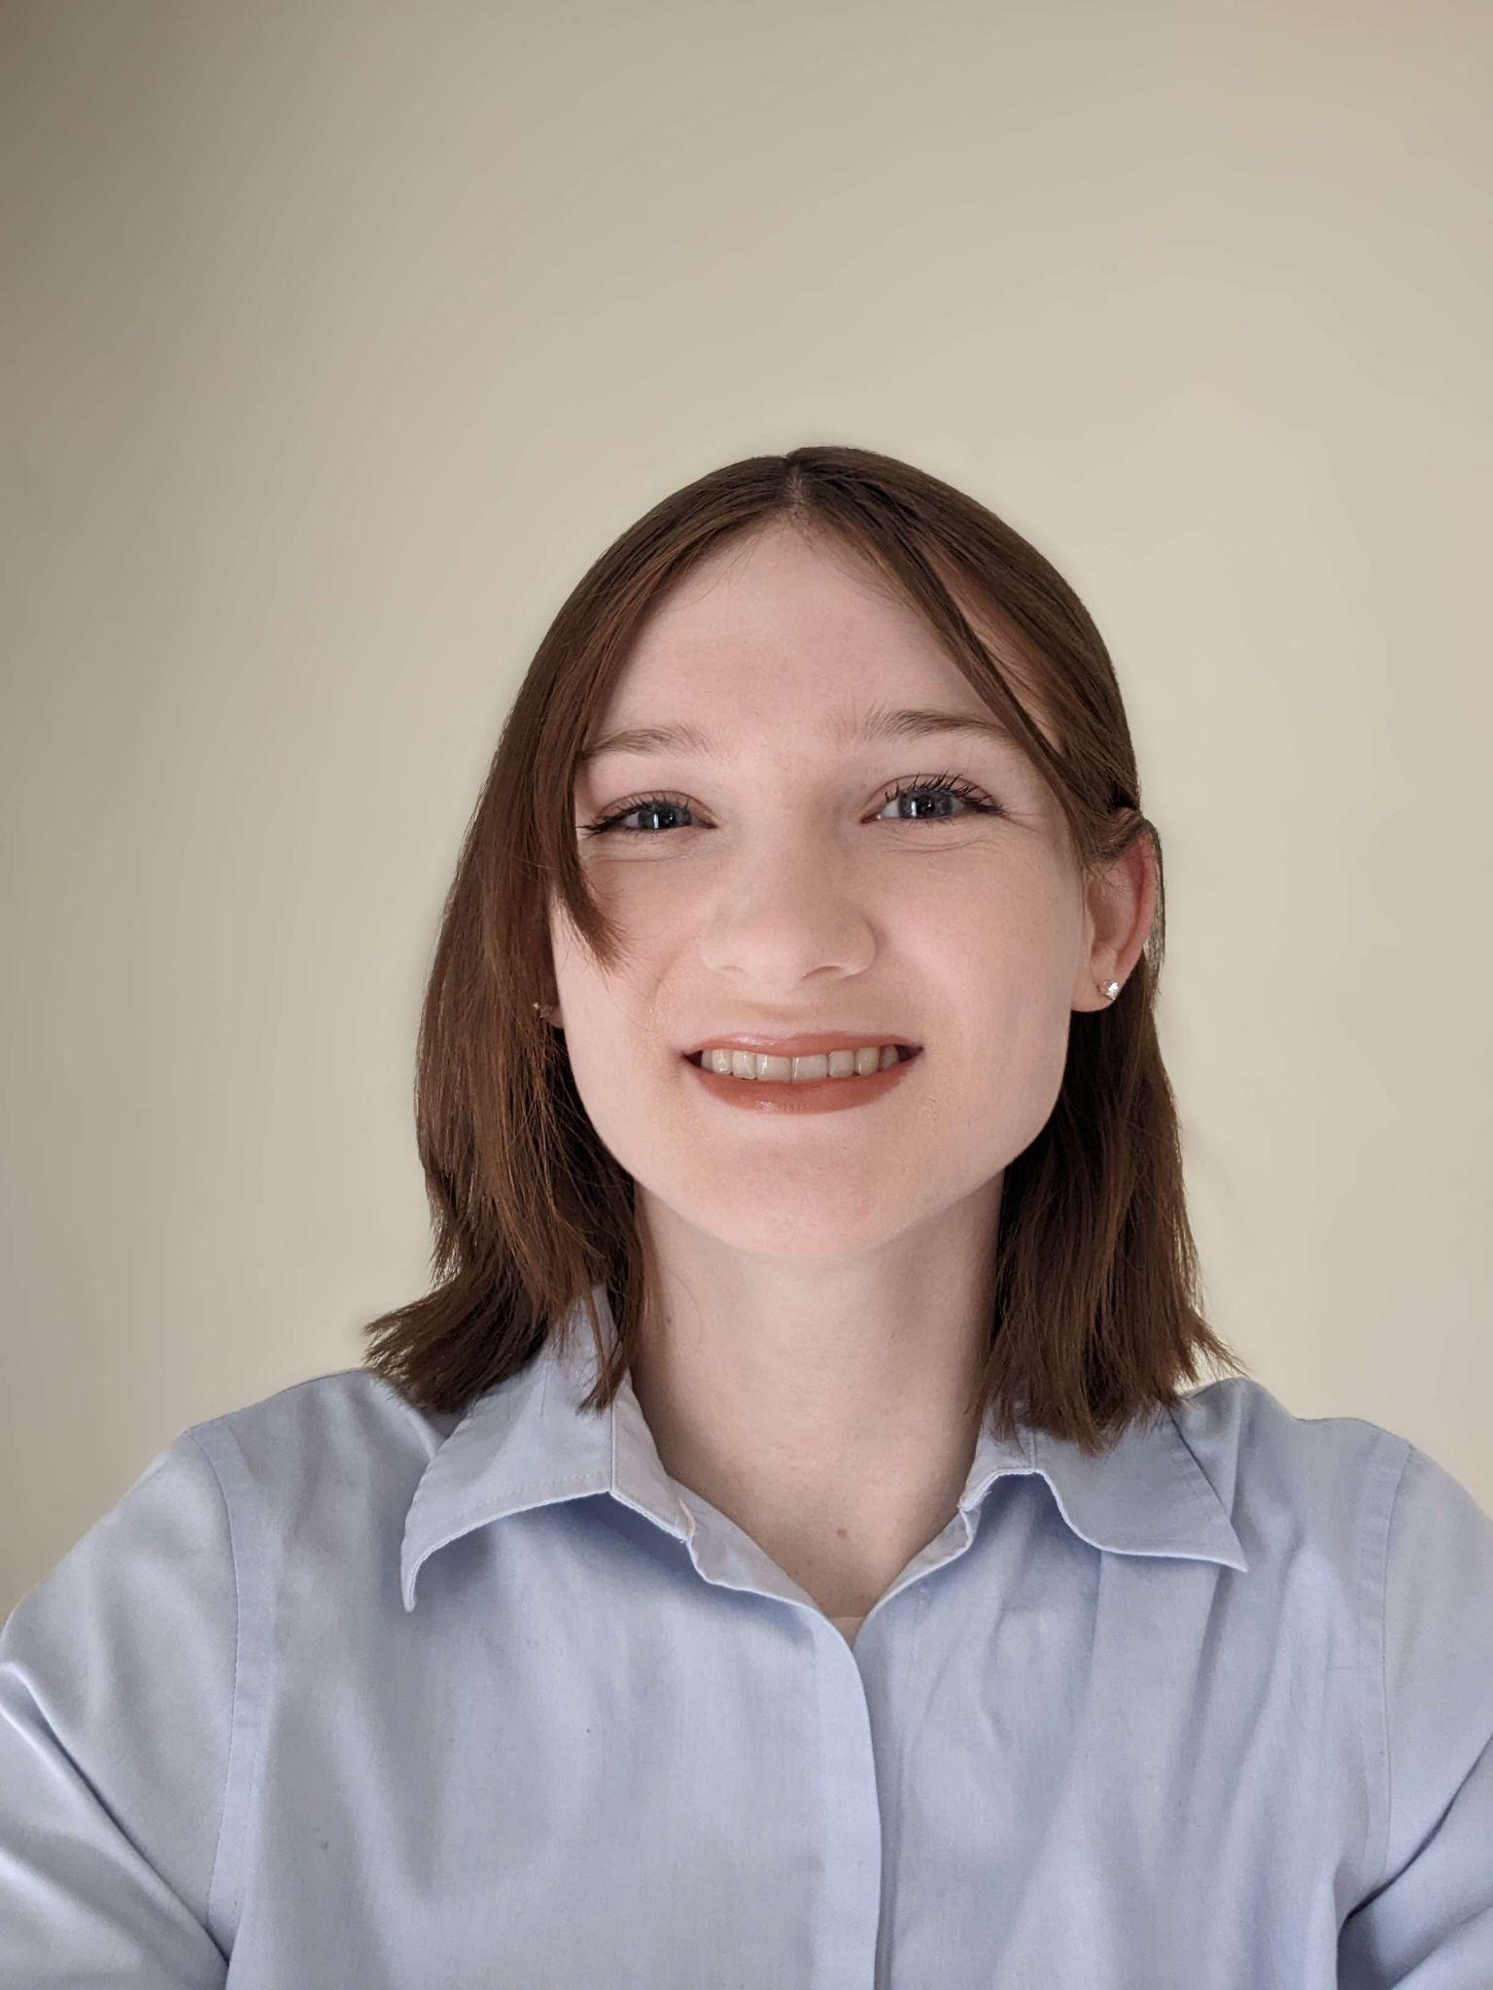
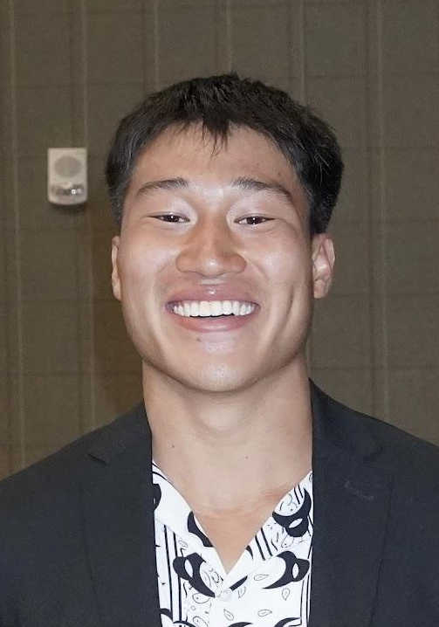
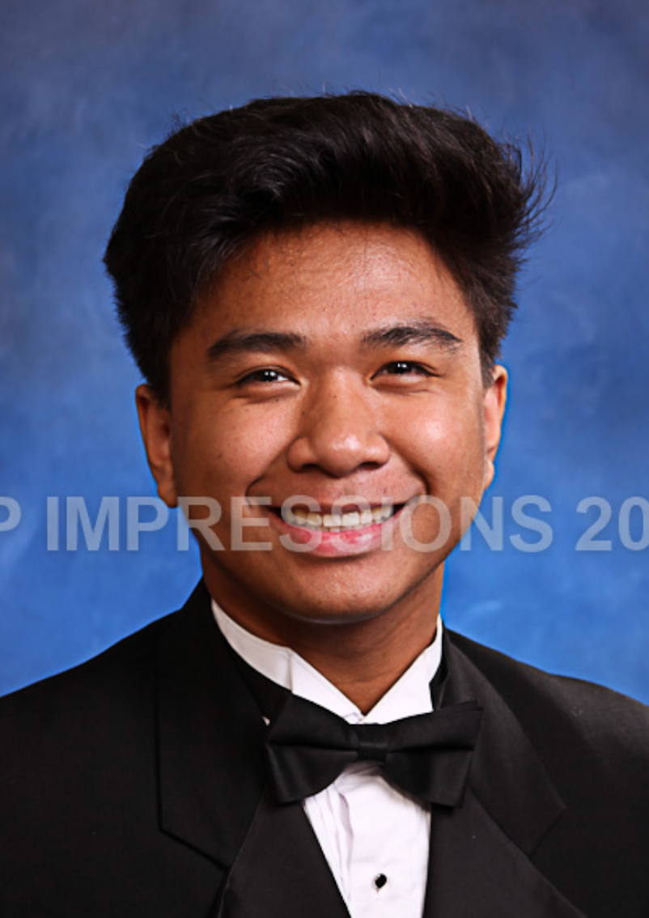
MEET THE TEAM
Kalino Ruiz
Brent Marin
Isabel Price
Caleb Mok
Matthew Manuel

Slide 4
Progress Report - Where we’re at
So far, we have completed:
Customer needs, Mission statement, Project proposal presentation
Our plan for the this week - Start working on design:
Draw some sketches, confirm proof of concept calculations, start on thermodynamics energy balance/diagram

Slide 5
Calculation Plan
Thermodynamics
List of all sources of heat/work added in the refrigerator
Create a diagram of the system
Ultimate goal: determine temperature and pressure requirements at all points and choose proper refrigeration components
Heat transfer
Improve upon proof of concept calculations - remove assumptions

Slide 6
QUESTIONS
Dr. Yi - Could you please post the assignment information and video about the Design Specifications

